Slide 1
School of Geography and Geology
McMaster University
Advanced Topics in Spatial Statistics
Session 10
Spatially Continuous Data I

Slide 2
Matters arising
Course refinement exercise
  Specific changes:
    Coffee maker for breaks
    More examples from the environmental sciences
    Focus more on modeling (100%)
  Other comments:
    Lab instructor/TA availability
    Communication between instructor and TA

Slide 3
This session
Definitions
Visualization and exploration of spatially continuous data
  First order properties
  Second order properties
Modeling spatially continuous data
  Main methods
  Trend surface analysis: examples

Slide 4
Definitions
Examples of data in the environmental sciences
  Ore grades in a mineral deposit
  Depth and thickness of a geological layer
  Density of trees of a certain species in a forest
  Soil properties in a region
  Rainfall over a catchment area
  Pressure, temperature and wind velocity
  Piezometric-head data
Notes:
Examples of data in the environmental sciences. All these examples are characterized by being “continuous” in space. In theory, we could measure them at any location
Density of trees of a certain species: reforestation example in Japan
Piezometric-head data: Wolfcamp aquifer data, and the location of a high level toxic waste disposal facility.

Slide 5
Definitions
Spatially continuous data
  Also known as Geostatistical data
  Tension between full information – limited information (discrete sampling)
  Emphasis is on continuity: how does dependence of spatial structure vary with distance?
Notes:
The question of how dependence varies with distance is relevant because usually we don’t have full information, but only limited information.
In some cases, we don’t have full information because of the nature of the process. For example, in the oil and mining industry, it is impossible to know with certainty the actual distribution, concentration, etc. of minerals. At most we can sample a few locations, to obtain limited information.
Even when the object of our measurements is not underground, hidden from sight, it is never economic or practical to obtain measurements at all possible locations. Think air monitoring stations.

Slide 6
Definitions
Spatially continuous data in the social sciences
  Land values
  House prices?
  Personal income?
Notes:
Two points: it is up to the analyst to decide whether the process can be approximated by a spatial process; and one additional property of spatially continuous data is that the locations are fixed.

Slide 7
Definitions
Research questions
  Structural analysis
  Interpolation/prediction
  Quantifying uncertainty

Slide 8
Visualization and Exploration of Spatially Continuous Process
Visualization
  Proportional symbol maps
  Triangulated irregular networks (TIN)
Exploration
  Spatial moving averages
  Methods based on tessellations
  Kernel estimation
  Variogram and covariogram (second order properties)

Slide 9
Modeling Spatially Continuous Data
Trend surface analysis
Generalized least squares
Modeling variograms
Kriging

Slide 10
Example
Wolfcamp aquifer (Texas)
  High level nuclear waste depository (U.S.)
  Candidate locations: Texas, Washington state, Nevada
  68,000 waste canisters placed underground, surrounded by salt
  Covering an area of about 2 square miles
  US Department of Energy stipulates that canisters must be isolated by 10,000 years

Slide 11
Example
Wolfcamp aquifer (Texas)
  Potential issues
    Leaks
    Tiny quantities of water in the salt could migrate towards the canisters
    Salt+water → hydrocloric acid could corrode canisters
    Contamination of aquifer

Slide 12
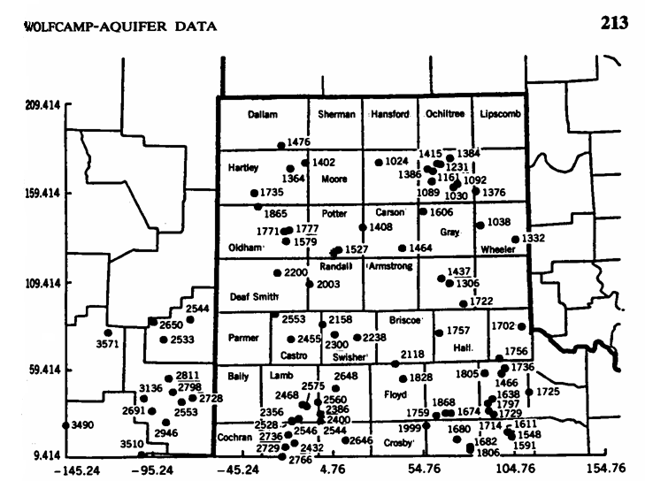
Example

Slide 13
Example: Wolfcamp Aquifer
Data
  Piezometric head at 85 locations in Texas panhandle (h)
Geostatistical problems
  Determine sites at risk
  Interpolate surface
  Quantify uncertainty (location of monitoring stations)

Slide 14
Example: Wolfcamp Aquifer
Spatial distribution of observations

Slide 15
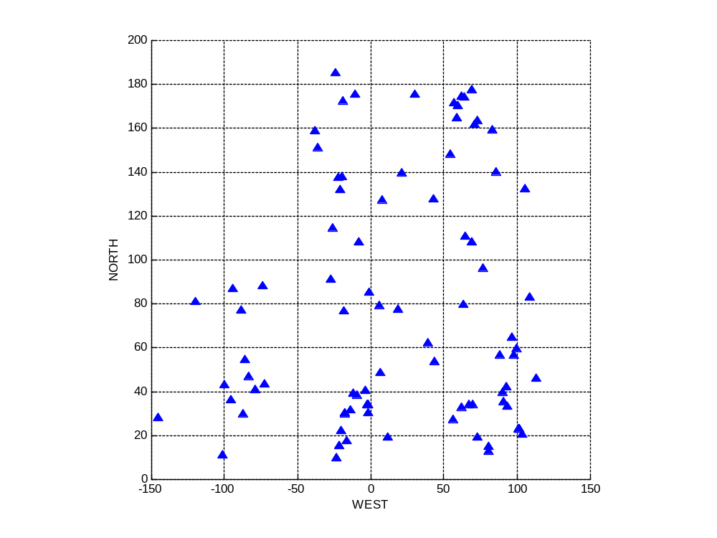
Example: Wolfcamp Aquifer
Spatial distribution of observations

Slide 16
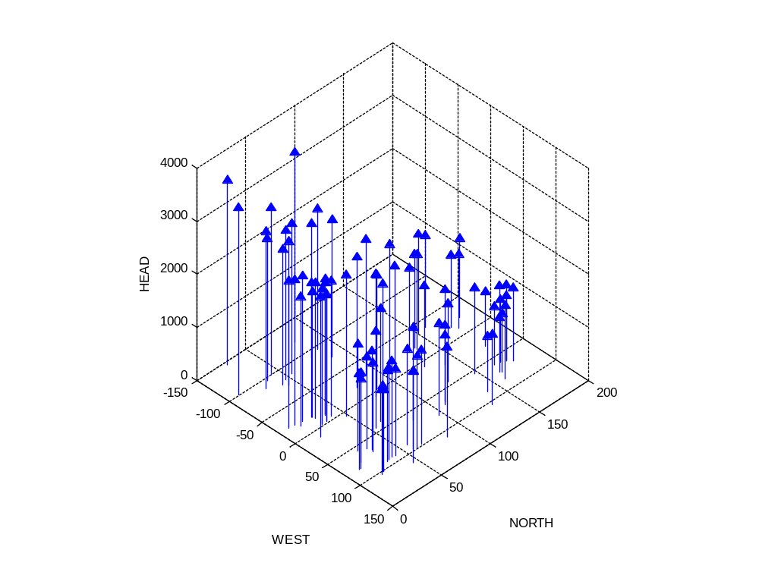
Example: Wolfcamp Aquifer
Spatial distribution of observations

Slide 17
Multiple Regression Analysis
Y
b₂
X₂
b₁
a
X₁

Slide 18
Trend Surface Analysis
A method to model the first order component of a spatial process
Multiple regression analysis using the coordinates of the points as explanatory variables

Slide 19
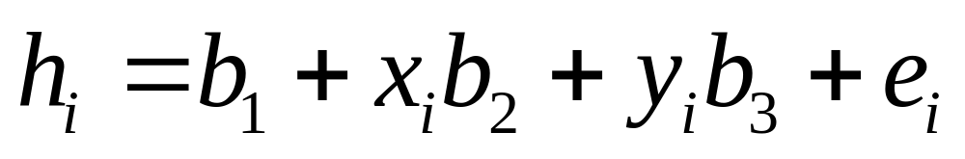
Trend Surface Analysis
Linear trend surface
  h: head
  b₁ , b₂ , b₃: regression parameters
  x , y: coordinates of point i

Slide 20
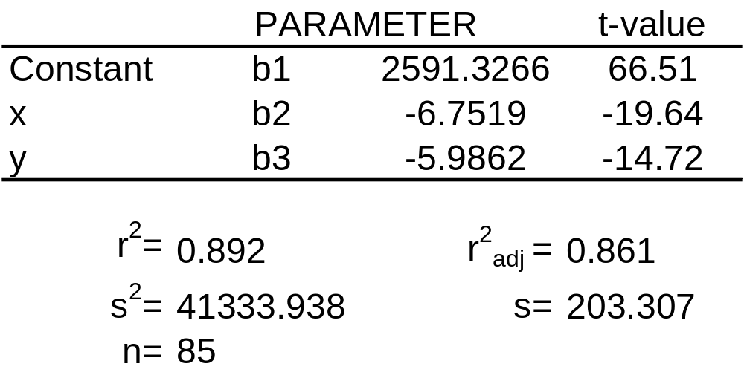
Trend Surface Analysis
Linear trend surface

Slide 21
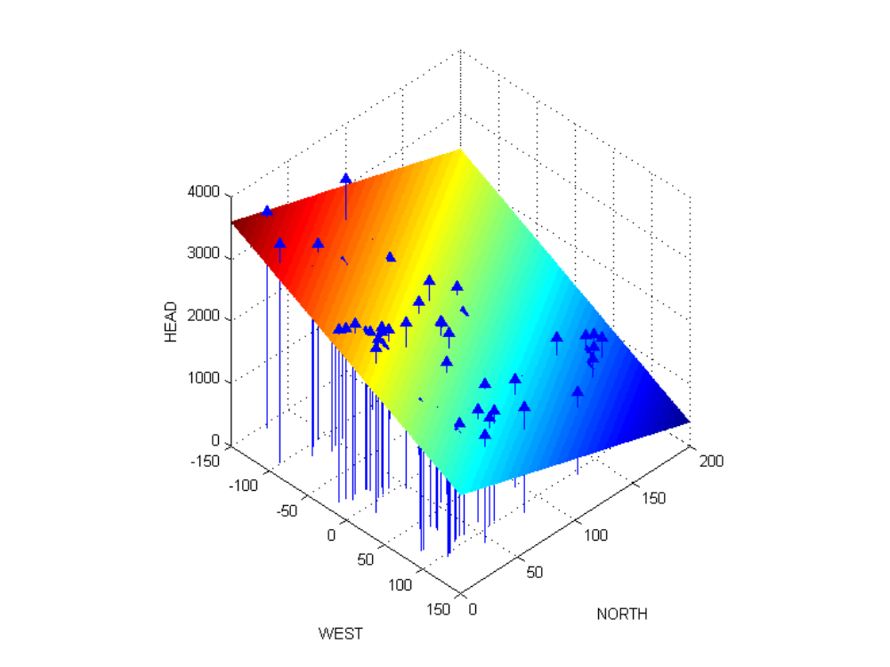
Trend Surface Analysis
Linear trend surface

Slide 22
Trend Surface Analysis
Quadratic trend surface
  h: head
  b₁ , b₂ ,…, b₆ : regression parameters
  x , y: coordinates of point i

Slide 23
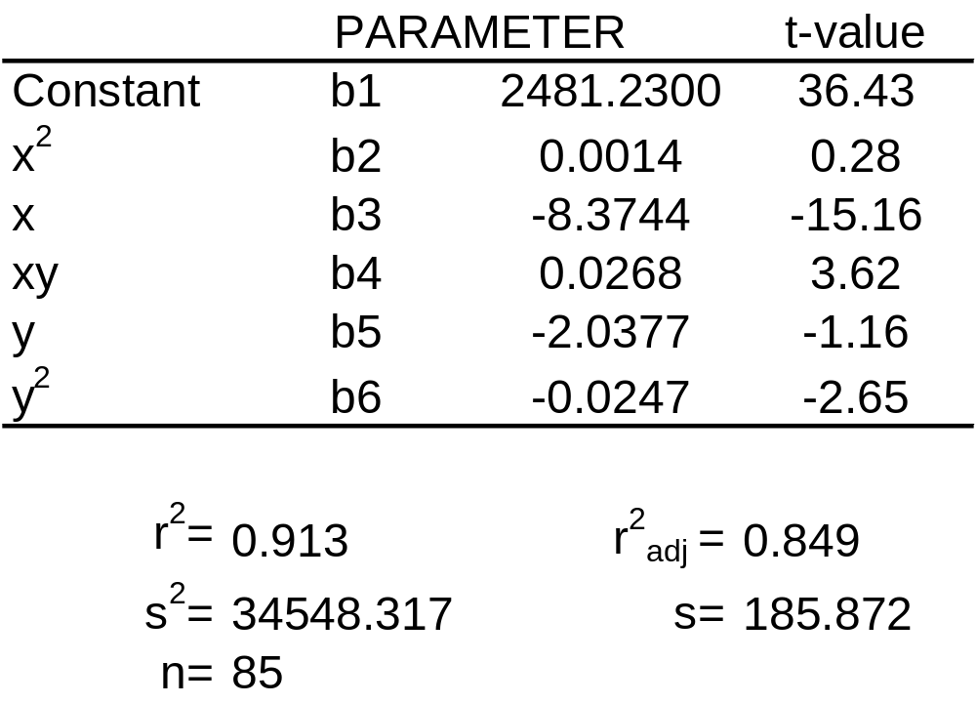
Trend Surface Analysis
Quadratic trend surface

Slide 24
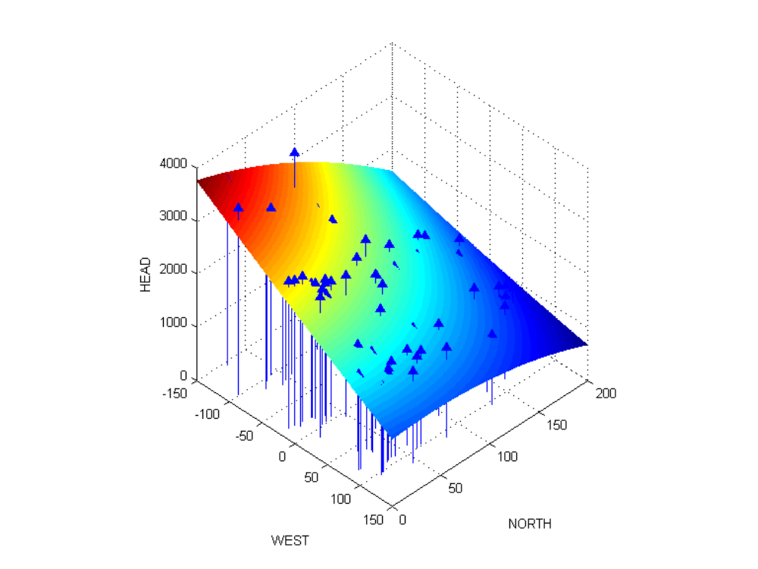
Trend Surface Analysis
Quadratic trend surface

Slide 25
Trend Surface Analysis
Higher order polynomials
  Cubic
  Quartic
  …

Slide 26
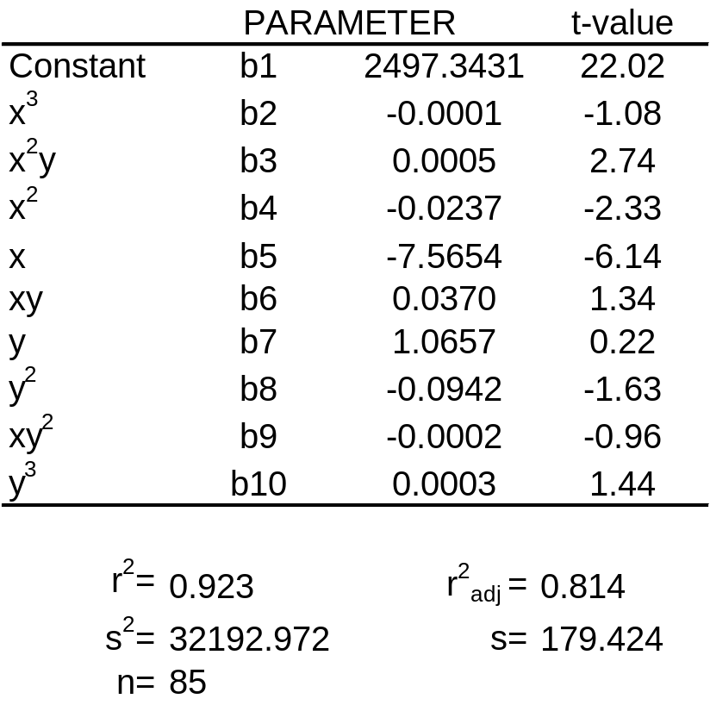
Trend Surface Analysis
Cubic trend surface

Slide 27
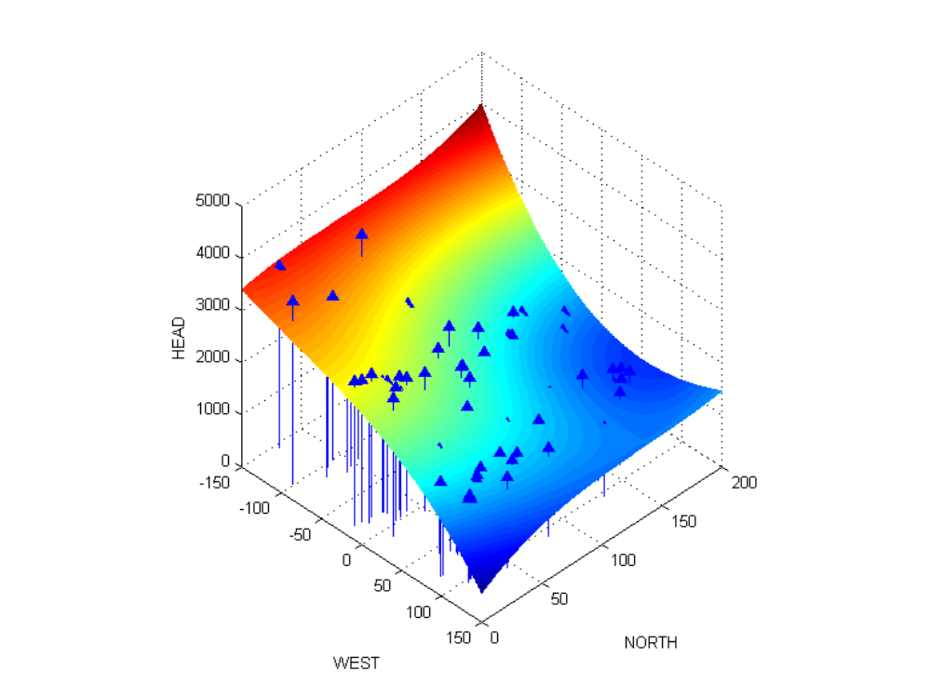
Trend Surface Analysis
Cubic trend surface

Slide 28
Trend Surface Analysis
Explanation vs. prediction?
Potential issues
  Multicollinearity
  Trend surfaces tend to “curl” around the edges
This example: fairly good fit

Slide 29
Example
Walker Lake (Nevada)
  Concentration of pollution
  Soil remediation
Data
  470 observations (pollution ppm)
Geostatistical problem
  Produce indicator maps showing the areas where pollution concentrations exceed a given threshold

Slide 30
Trend Surface Analysis
Linear trend surface
Quadratic trend surface
Cubic trend surface

Slide 31
Trend Surface Analysis
In addition to multicollinearity and curly surfaces
Spatial structure is missing

Slide 32
Next…
Spatially continuous data II
  Spatial structure
  Second order properties

